Slide 1
Lecture 8 ➔ Control and Robots
András Lőrincz
Department of Artificial Intelligence
Faculty of Informatics

Slide 2
Robots

Slide 3
Robots

Slide 4
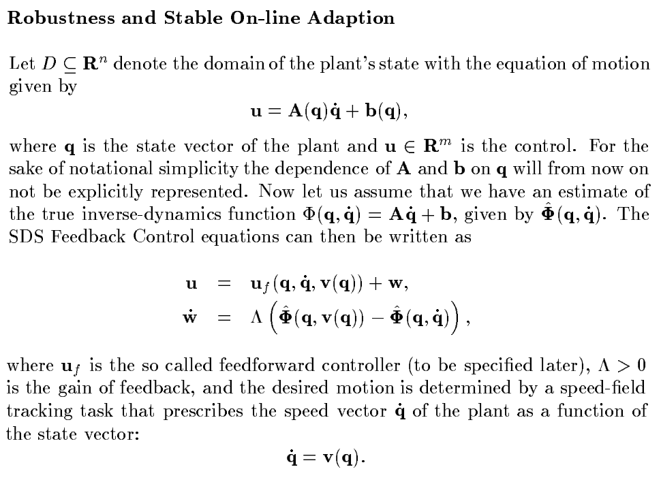
A little theory
This is the very basics of robotics

Slide 5
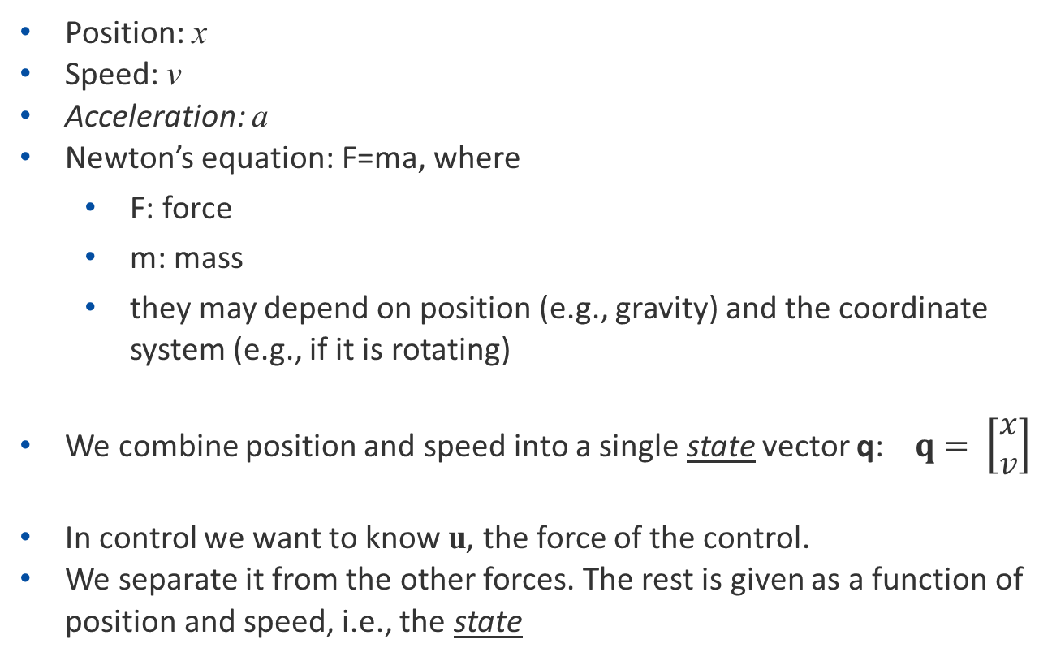
Basics: notations and simplified notations
Tasks:
we know F and compute a: dynamics of the system
we want a and compute F: inverse dynamics
Position: x
Speed: v
Acceleration: a
Newton’s equation: F=ma, where
F: force
m: mass
they may depend on position (e.g., gravity) and the coordinate system (e.g., if it is rotating)
We combine position and speed into a single state vector q: $q= \left[\begin{matrix}x \\ v\end{matrix}\right]$
In control we want to know u, the force of the control.
We separate it from the other forces. The rest is given as a function of position and speed, i.e., the state
speed and acceleration
simple form
state: position and speed

Slide 6
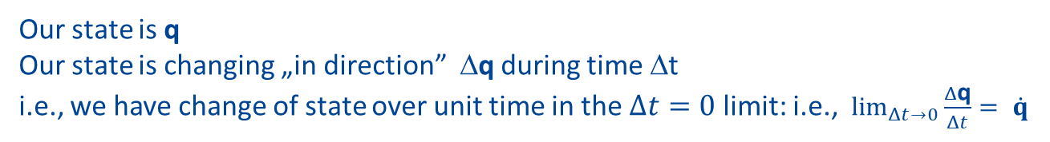
Newton eqs in control terms
Our state is q
Our state is changing „in direction” Δq during time Δt
i.e., we have change of state over unit time in the $Δt=0$ limit: i.e., $\lim_{Δt→0}{\frac{Δ\text{q}}{Δt}}= \dot{q}$
*
Newton and the control equation

Slide 7
Assume a desired direction field in state space
Our state is q
Our state is changing „in direction” Δq during time Δt
i.e., we have change of state over unit time in the $Δt=0$ limit: i.e., $\lim_{Δt→0}{\frac{Δ\text{q}}{Δt}}= \dot{q}$
*
Field: prescribed direction at every point
Newton and the control equation
1st guess for
correction
Desired direction differs from the actual direction
We have to correct for that

Slide 8
Problems with the 1st guess
1st guess for
correction
Problems:
This deviation occured at time t.
What should be the duration of the correction?
What if the correction itself is imprecise?
Solution:
We correct with and infinitesimally small amount during an infinitesimally short time interval

Slide 9

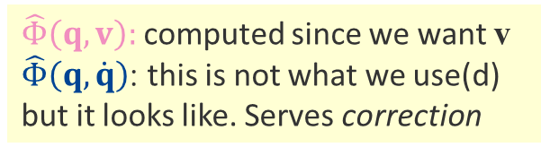
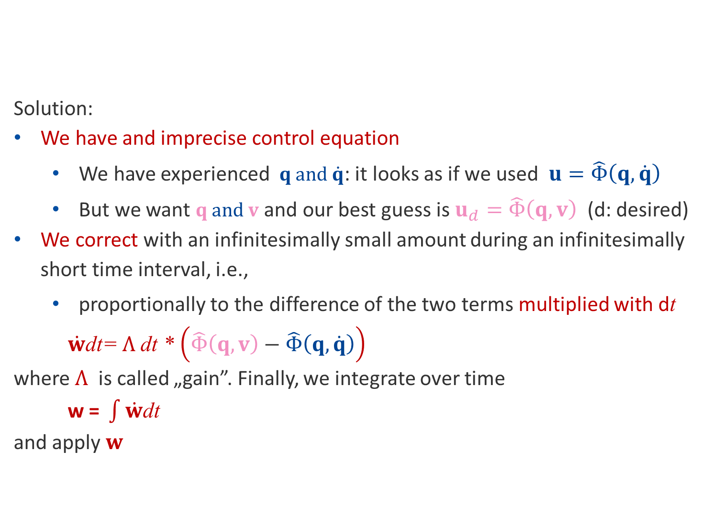

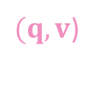
Solution
1st guess for
correction
Solution:
We have and imprecise control equation
We have experienced $q \text{and} \dot{q}$: it looks as if we used $u=\hat{Φ}\left(q,\dot{q}\right)$
But we want $q \text{and} v$ and our best guess is $u_{d}=\hat{Φ}\left(q,v\right)$ (d: desired)
We correct with an infinitesimally small amount during an infinitesimally short time interval, i.e.,
proportionally to the difference of the two terms multiplied with dt
$\dot{w}$dt= $Λ$dt * $\left(\hat{Φ}\left(q,v\right)−\hat{Φ}\left(q,\dot{q}\right)\right)$
where $Λ$ is called „gain”. Finally, we integrate over time
$\text{w}\text{ = }\int{\dot{w}\text{dt}}$
and apply $w$
($q,\dot{q}$)
*
$(q,v$)
shorthand
$$=\hat{Φ}\left(q,\dot{q}\right)$$
$\hat{Φ}\left(q,v\right):$ computed since we want v
$\hat{Φ}\left(q,\dot{q}\right)$: this is not what we use(d)
but it looks like. Serves correction

Slide 10

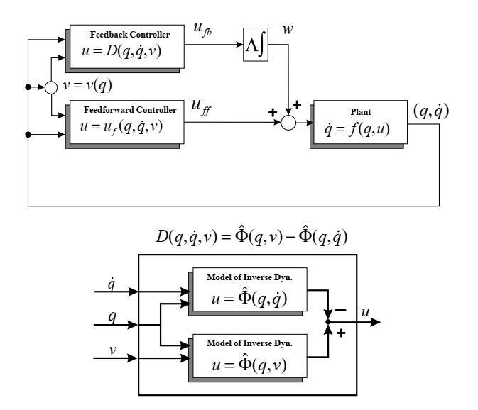


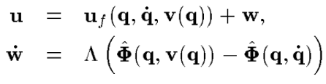

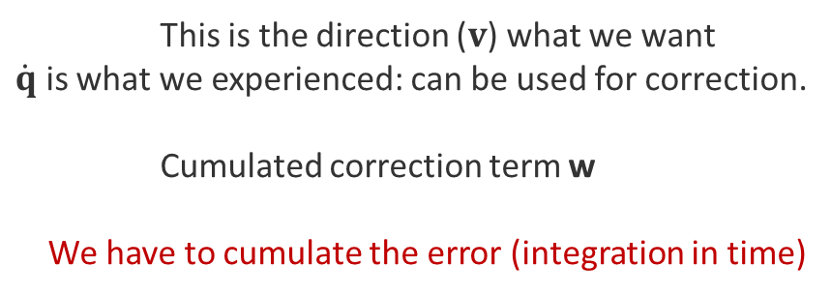

This is the direction ($v$) what we want
$\dot{q}$ is what we experienced: can be used for correction.
Cumulated correction term w
We have to cumulate the error (integration in time)
In a drawing:
This is perfect,
but we don’t have it
This is what we have:
and
where is the
main (feedforward, ’u_{ff}’) controller, and
is the correcting controller we use
for building a feedback controller (’u_{fb}’)
Legend
ff: feedforward
fb: feedback
D: shorthand
$$w$$
$$\dot{w}$$

Slide 11
The learning-by-doing principle
This is the control error at time t
It can be used for teaching!
under certain conditions → see next slide
We would like to learn this:
This is what we have
and
We correct using
at all instants
➔ we correct and train with the correction term!
Legend
ff: feedforward
fb: feedback
D: shorthand
$$w$$
$$\dot{w}$$

Slide 12
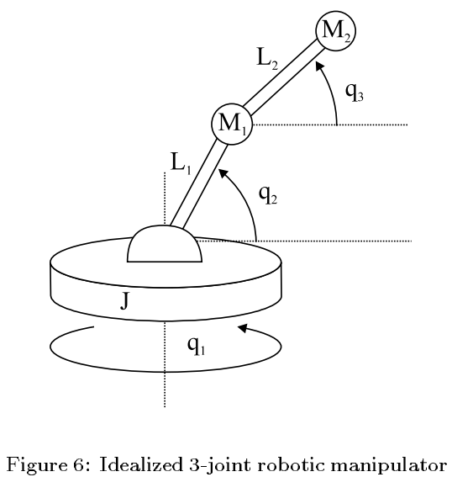
Advantages and disadvantages
Why do we need two inverse dynamics (two controllers)?
can be quite precise in general situations, but
some changes are possible.
For example,
the pendulum is a model for a crane and
the weight (M₂) may differ from time to time
Still, we want a precise movement
For our feedback controller
sign properness is required: distance d should decrease
no assumption is made on the mass
(*) Szita, Takács, Lőrincz. "ε-MDPs: Learning in varying environments." JMLR 2002
Note: u_{ff} can be u_{fb} , too
sign-properness constrains
RL can work with this method (*)
base
x_{f}, v_{f}=0
q₁
q₂
d
x_{i},v_{i}

Slide 13
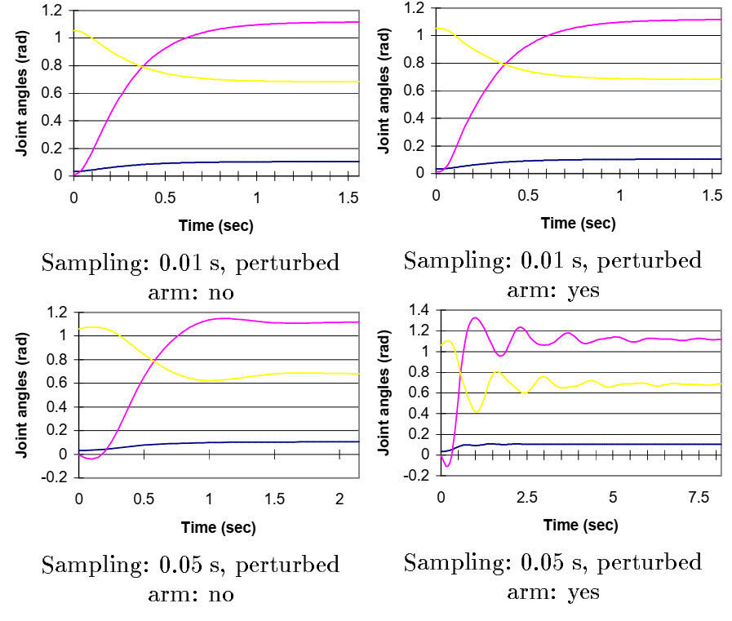
Advantages and disadvantages
We talked about correcting imprecise models under very strong assumptions
A „real” (i.e., idealized) example, the pendulum
No delay in
sampling
sensory processing
computation
effect of feedback
In case of delays, oscillations and instabilities appear

Slide 14

Making new laws
Why do you introduce new laws?
Regulations has led to error
It is error correction,
feedback to save the society
How should you do it?
quickly and overnight?
rarely and informing everybody to be able to adjust?
in a quickly changing world…
GDPR has little value 9/26/19 10:21 AM ➔ Our results suggest that even heavily sampled anonymized datasets are unlikely to satisfy the modern standards for anonymization set forth by GDPR and seriously challenge the technical and legal adequacy of the de-identification release-and-forget model.
➔ Using our model, we find that 99.98% of Americans would be correctly re-identified in any dataset using 15 demographic attributes.
GDPR took ~8 years to develop

Slide 15
What is faster
Control and its effects:
Law construction starts → results start to emerge
Developments that act against existing laws (e.g., hackers), or goodwill (e.g., ethics)
Is it possible to introduce laws just in time?
Model of the society is needed
Still, predicting the evolution of AI and technology seems highly imprecise
Situation is more complex due to the developments in
genetics
nanotechnology,
quantumtechnology,
AI

Slide 16
We should know more
Experiences in two EU projects:
Theoretical project
Knowledge of researchers considering law and ethics on control is limited
(i) we measure, (ii) we model, consider, design, optimize parameters, (ii) we talk to people to have public opinion before introduction, (iii) we decide, decision starts, and (iv) we monitor the outcome and measure public opinion
Practical (engineers and companies)
„Ethical factory” with ethical procedures
ethical products: does not seem possible
the procedures at the companies may be ethical
in specific cases (e.g., in banking), procedures and products are the same.

Slide 17
Differences
EU AI HLEG | OECD PAI | IEEE EAD
Human agency and oversight Technical robustness and safety Privacy and data governance Transparency, diversity, non-discrimination and fairness Societal and environmental well-being Accountability REGULATION | Benefit people and the planet Respects the rule of the law, human rights, democratic values and diversity Include approximate safeguards (e.g., human intervention) to ensure a fair and just society. Transparency and responsible disclosures Robust, secure, and safe Hold organizations and individuals accountable for proper functioning of AI OBSERVATORY | How can we ensure that A/IS do not infringe human rights? Effect of A/IS technologies on human-well being. How can we assure that designers, manufacturers, owners and operators of A/IS are responsible and accountable? How can we ensure that A/IS are transparent? How can we extend the benefits and minimize the risks of AI/AS technology beforehand STRATEGIC
HLEG: High Level Expert Group
PAI: Principles on AI
EAD: Ethically Aligned Design
A/IS: autonomous and intelligent systems

Slide 18
Few examples

Slide 21
Other robots
2019
https://youtu.be/Q7mahD-PH4o?t=1702
https://youtu.be/Q7mahD-PH4o?t=2985
https://youtu.be/Q7mahD-PH4o?t=3699
https://youtu.be/Q7mahD-PH4o?t=4694
2017
https://youtu.be/mb6W4PdN6sk?t=5
https://youtu.be/mb6W4PdN6sk?t=64
https://www.youtube.com/watch?v=GrQ9c5hmbFE

Slide 22
ITT
A
VÉGE!
lorincz@inf.elte.hu

Slide 23
Questions
What describes the state of a robot and its components?
What is feedforward control?
What is feedback control?
What are the intrinsic problems of controllers?
What is called learning-by-doing?
Why we may want two controllers, a feedforward one and a feedback one?
What does sign-properness means in term of geometry, e.g., distances

